Slide 1
FACE MASK DETECTION IN REAL TIME USING DEEP LEARNING

Slide 2
GROUP MEMBER INFORMATION
NAME | REGISTER ID
HARIKA ALIZA | 700749201
DEEPIKA IRRINKI | 700741218
MAHESH BABU PULLELA | 700757323
JAGADEESH VELAGA | 700741667

Slide 3
ROLE/RESPONSIBILITIES AND CONTRIBUTION IN PROJECT
Harika Aliza (700749201) – Analysis, Final Report, Code Review
Deepika Irrinki (700741218) – Analysis, Final Report, Code Review
Mahesh Babu Pullela (700757323) – Analysis, Model Evaluation, Code Implementation
Jagadeesh Velaga (700741667)– Analysis, Code Implementation, Model Evaluation

Slide 4
MOTIVATION
Face mask detection model enhances community safety using deep learning and computer vision.
Project employs TensorFlow, Keras, NumPy, and OpenCV for efficient model development and deployment.
Real-world applications include healthcare, transportation, and manufacturing sectors.
Model integration improves safety measures and boosts efficiency in various industries.
Project's motivation centers on positive impact: preventing disease spread, enhancing safety, and driving innovation.

Slide 5
OBJECTIVES
The Objective of this project is to develop a Face Mask Detection system using deep learning techniques and computer vision to address the safety concerns posed by the COVID-19 pandemic.
To explore and implement the MobileNetV2 architecture for real-time mask detection, ensuring accurate identification of individuals wearing and not wearing masks.
To provide a comprehensive study covering both theoretical and practical aspects, educating on Python programming, deep learning, and convolutional neural networks for object detection applications.

Slide 6
RELATED WORK
To develop a face mask detection, we use deep learning and CNNs through TensorFlow and Keras for efficient training and deployment, maximizing efficiency with Python's for efficient data representation, preprocessing.
Adopting the MobileNetV2 architecture, the system achieves real-time mask detection, striking an optimal balance between precision and computational speed.
OpenCV is employed for comprehensive image preprocessing and feature extraction which offers a suite of advanced computer vision algorithms, aiding in object localization and classification within images or video frames.
In Data Preprocessing we employing Python libraries like NumPy and SciPy for rigorous data preprocessing and augmentation to enhance model robustness and generalizability.
In Training & Validation Phases parameters are considered(labeled datasets), to ensure optimal performance and prevention of overfitting.
The ultimate motivation for the project lies in its potential positive impact on people's lives, whether through preventing the spread of disease, enhancing public safety, or driving technological advancement, contributing to a safer, healthier, and more innovative future.

Slide 7
SYSTEM ARCHITECTURE

Slide 8
PROBLEM STATEMENT
The current dataset may lead to overfitting, reducing the model's ability to generalize across diverse scenarios.
This model mainly relies on visual data, potentially limiting its effectiveness in uncertain visual conditions.
The system detects masks but does not provide immediate feedback to individuals, affecting the user experience and compliance.
The use of a fixed learning rate may not yield optimal model convergence during training.
Continuous face detection and data storage may raise privacy issues, especially when sensitive data is involved.
The model only detects the presence or absence of a mask without evaluating its quality or fit.
The model may become less effective over time due to evolving face mask designs and usage patterns.
The current system relies on a centralized camera setup, limiting its scalability and deployment flexibility.

Slide 9
PROPOSED SOLUTION
Implement advanced data augmentation techniques to generate more diverse training samples, improving model robustness and accuracy.
Integrate other modalities like thermal imaging or infrared sensors to enhance face mask detection capabilities in challenging visual conditions.
Develop a user-friendly interface that provides immediate feedback to individuals, encouraging correct mask usage or notifying them of non-compliance.
Implement adaptive learning rate techniques to dynamically adjust the learning rate during training, improving model convergence and accuracy.
Incorporate edge computing or federated learning techniques to process and analyze data locally, reducing the need for centralized storage of sensitive data.
Extend the model to assess the quality and fit of masks worn by individuals, ensuring they meet recommended standards for effective protection.
Integrate crowd analysis algorithms to monitor social distancing and crowd density, providing comprehensive safety measures in public spaces.

Slide 10
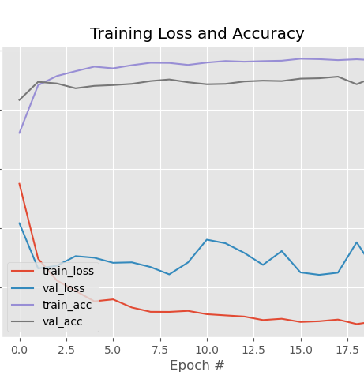
TRAINING
To run the model, the computer’s command prompt was opened and navigated to the location where the relevant training file was located. The python keyword was typed, followed by the file name train mask detector.py, and the enter key was hit to start it. After that, the training phase of this model started. All the images had to be trained, which took a lengthy time

Slide 11
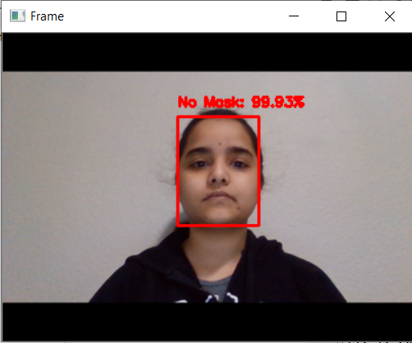
RESULTS
The machine ran a face detection algorithm. In a window named frame, a face has been detected. The detector categorized the face as mask and no mask with an accuracy score of indicating that the face mask was identified.
Image without mask along with text showing Accuracy.

Slide 12
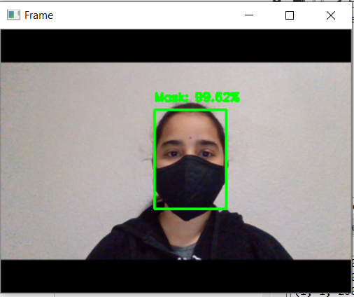
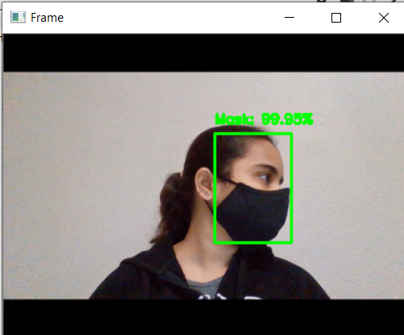
RESULTS
Image with mask along with text showing Accuracy.
Image with mask along with text showing Accuracy in different angles.

Slide 13
REFERENCE
A. Negi, K. Kumar, P. Chauhan and R. S. Rajput, "Deep Neural Architecture for Face mask Detection on Simulated Masked Face Dataset against Covid-19 Pandemic," 2021 International Conference on Computing, Communication, and Intelligent Systems (ICCCIS), Greater Noida, India, 2021.
A. Nowrin, S. Afroz, M. S. Rahman, I. Mahmud and Y. -Z. Cho, "Comprehensive Review on Facemask Detection Techniques in the Context of Covid-19,."
Cherry Khosla, Baljit Singh Saini. 06 August 2020."Enhancing Performance of Deep Learning Models with different Data Augmentation Techniques: A Survey."
F. Firdaus and R. Munir, "Masked Face Recognition using Deep Learning based on Unmasked Area," 2022.
Muhammad Chaidir, Taufik Fuadi Abidin, Hizir, Kahlil Muchtar. 01 November 2022,"HyperStyle-Based Data Augmentation to Improve the Performance of Face Recognition Model."
Madhusmita Sarma, Anjan Kumar Talukdar, Kandarpa Kumar Sarma. 10 February 2022,"Deep Learning Based Face Mask Detection System for COVID-19 Control."
N. Mishra, S. Chaturvedi, S. Laxmi, Rohit.20 June 2022,"A Deep Learning Based Approach to Mask Detection."
P. Poonpinij, S. Tarnpradab, N. N. Lumpoon and N. Wattanapongsakorn, "Masked Face Recognition and Identification Using Convolutional Neural Networks," 2023.

Slide 14

H HARIKA ALIZA Presented By ARIKA ALIZA DEEPIKA IRRINKI – 700741218 HARIKA ALIZA - 700749201 MAHESH BABU PULLELA - 700757323 JAGADEESH VELAGA - 700741667

